Slide 1
The History of Indigenous Guanajuato (October 2019) by John P. Schmal

Slide 2
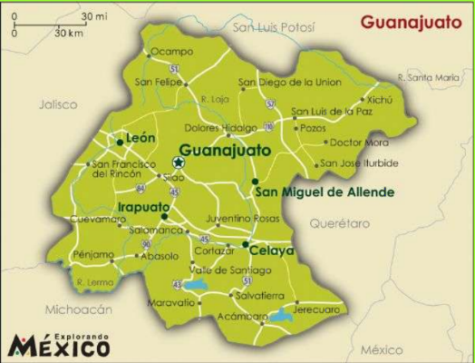
The State of Guanajuato
Guanajuato is a relatively small state – twenty-second in terms of size among the Republic’s states – with a surface area of 30,608 square kilometers of territory, giving it 1.6% of the national territory. Politically, the State is divided into 46 municipios.
Guanajuato’s 2010 population was 5,853,677, representing 4.9% of Mexico’s total population and ranking six among the 31 states and the Distrito Federal.
Source: Nacho Ferrer Vidal , “Mapa de Guanajuato,” Mapas de America, March 23, 2012.
Copyright © 2019 by John P. Schmal.
All Rights Reserved.
2

Slide 3
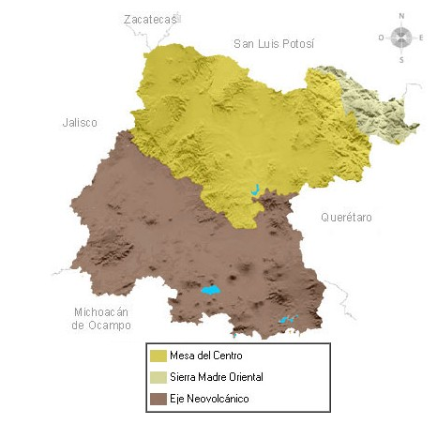
Guanajuato’s Relief
Guanajuato has three physiographic provinces. The Sierra Madre Oriental Mountains in the northeast occupies only 5.32% of the state territory.
The Mesa del Centro of the north and northwest occupies 45.31% of the State territory and consists of plains, interrupted by scattered mountain ranges.
The Eje Neovolcánico (Neovolcanic Axis) occupies 49.37% of the state territory and consists of great volcanic mountain ranges situated among the extensive plains of lake basins.
Sources: Cuéntame, Página de inicio / Información por entidad / Guanajuato; INEGI. Anuario Estadístico y Geográfico de Guanajuato 2017.
Copyright © 2019 by John P. Schmal.
All Rights Reserved.
3

Slide 4
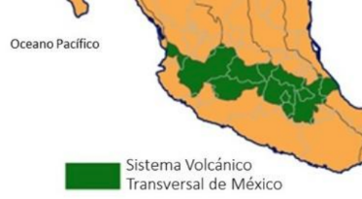
The Neovolcanic Axis
The Eje Neovolcánico – also known as the Neovolcanic Axis or Transverse Volcanic System – crosses through central Mexico from Veracruz on the Gulf coast to Jalisco on the Pacific coast.
It has an approximate length of 920 km (572 miles). Its width varies from 400 km (249 miles) to about 100 km (62 miles).
Source: Lifepersona.com, “Transversal Volcanic System of Mexico: Characteristics and Location.” Online: https://www.lifepersona.com/transversal-volcanic-system-of-mexico-characteristics-and-location.
Included in this region is the Michoacán–Guanajuato Volcanic Field, which contains 1,400 vents. Its most famous volcano was the Parícutin volcano which began in 1943 as a fissure in a cornfield owned by a Purépecha farmer and grew quickly. The nearby villages of Parícutin and San Juan Parangaricutiro were both buried in lava and ash. However, the eruption of El Parícutin ended in 1952 and it is believed to be monogenetic volcano, which means that once it has finished erupting, it will never erupt again. Any new eruptions in the Michoacán-Guanajuato volcanic field will erupt in a new location.
Copyright © 2019 by John P. Schmal.
All Rights Reserved.
4

Slide 5
The Purépecha People
For more than a thousand years, the Purépecha Indians have occupied Michoacán and portions of present-day Guanajuato and Jalisco. The name Michoacán derives from the Náhuatl terms, michin (fish) and hua (those who have) and can (place) which roughly translates into “Place of the Fisherman.”
In the 13th and 14th centuries, the Purépecha people consisted of several small city-states that competed with each other in the military and economic realms. These city-states were internally stratified, with elaborate civic and religious architecture.
Eventually, a leader named Tariacuri (who reigned circa about 1350-1408) consolidated power in the city of Pátzcuaro, conquering the other city-states in the Lake Pátzcuaro Basin and establishing the Triple Alliance. During the 15th Century, a rapid process of cultural assimilation and political unification brought the different groups of the region into a United Tarascan ethnicity and socio-political system.
Sources: Tumblr. Tlatollotl: What Was the Tarascan Government Like”; Gerónimo de Acalá, Relación de las Ceremonias y Ritos y Poblacion y Gobierno de los Indios de la Provincia de Michoacán (2013); J. Benedict Warren, The Conquest of Michoacán: Spanish Domination of the Tarascan Kingdom 1521-1530 (1985); Mike Cartwright, "Tarascan Civilization." Ancient History Encyclopedia (Last modified December 11, 2013).
Copyright © 2019 by John P. Schmal.
All Rights Reserved.

Slide 6
The Purepécha of Michoacán
Eventually, the Purépecha Kingdom would control an area of at least 45,000 square miles (72,500 square kilometers), including parts of the present-day states of Guanajuato, Guerrero, Colima, and Jalisco. However, 240 miles to the east, the Aztec Empire, centered in Tenochtitlán, had begun its ascendancy in the Valley of Mexico.
The Purepécha Empire (Circa 1500)
Map Source: Tumblr. Tlatollotl: What Was the Tarascan Government Like.” Online: https://tlatollotl.tumblr.com/post/154284146371/what-was-the-tarascan-government-like.
Source: Mike Cartwright, "Tarascan Civilization." Ancient History Encyclopedia (Last modified December 11, 2013). Online: https://www.ancient.eu/Tarascan_Civilization/.
Copyright © 2019 by John P. Schmal.
All Rights Reserved.

Slide 7
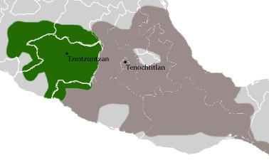
The Purepécha Versus The Aztecs
Over time, the Aztecs came into conflict with their western neighbors. In 1468, the Aztecs launched a powerful offensive against the Purépecha. This offensive turned into a bloody and protracted conflict that lasted until 1478.
The Purepécha and Aztec Empires (Circa 1500)
Finally, in 1478, a force of 32,000 Aztec warriors engaged an army of 50,000 Tarascans in the Battle of Taximaroa (today the city of Hidalgo). After a daylong battle, the Aztecs withdrew, with a loss of 20,000 warriors. The Purépecha continued to put off the Aztecs up to the arrival of the Spaniards. In the map at the upper right, the Tarascan Empire is green, while the Aztec Empire is light purple.
Source: Mike Cartwright, "Tarascan Civilization." Ancient History Encyclopedia (Last modified December 11, 2013).
Online: https://www.ancient.eu/Tarascan_Civilization/.
Copyright © 2019 by John P. Schmal.
All Rights Reserved.

Slide 8
The King is Murdered (1530)
In December 1529, The President of the First Audiencia in Nueva España (Mexico), Nuño Beltrán de Guzmán, left Mexico City with a force of 350 Spaniards and over 10,000 Indian allies. He also brought along King (Cazonci) Tangoxoán as a hostage, demanding that he turn over all his gold to Guzmán.
On February 5, 1530, the Cazonci was accused of treason and interrogated under torture. He was finally executed on Feb. 14, 1530, allegedly because he had abandoned Christianity and had lapsed back into paganism. Guzmán had Tangoxoán dragged behind a horse and finally burned at the stake.
According to the historian J. Benedict Warren, “the execution of the Cazonci was the most symbolic act marking the end of the pre-Spanish kingdom of Michoacán and the completion of the Spanish conquest of the region.” In the following decades, Tarascan puppet rulers were installed by the Spanish government to rule the area.
Source: J. Benedict Warren, The Conquest of Michoacán: Spanish Domination of the Tarascan Kingdom 1521-1530 (1985).
Copyright © 2019 by John P. Schmal.
All Rights Reserved.

Slide 9
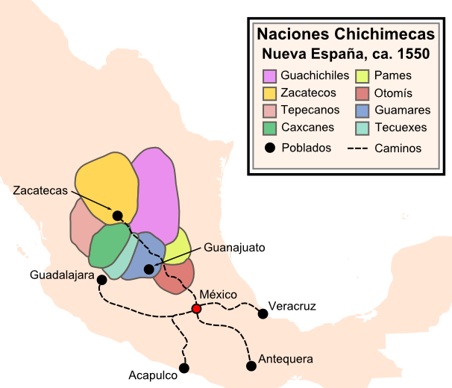
The Chichimeca Nations
“Chichimecas” was the collective name for a wide range of indigenous groups living throughout Zacatecas, San Luis Potosí, Jalisco, Aguascalientes, Jalisco and Guanajuato. The Chichimecs were not a single people sharing a common language, but consisted of several indigenous groups living through the large swathe of territory known to the Spaniards as “La Gran Chichimeca.”
Source: Philip Wayne Powell, “Soldiers, Indians and Silver: North America's First Frontier War" (Tempe, Arizona: Center for Latin American Studies, Arizona State University, 1973). Map Source: Wikipedia, “Chichimeca War.”
Copyright © 2019 by John P. Schmal.
All Rights Reserved.

Slide 10
The Chichimecas: Assimilation & Mestizaje
From 1550 to 1590, the Chichimeca War was waged by the Chichimecas against the Spaniards who were settling in their territory. Unable to decisively defeat the native groups, the Spanish initiated a “peace by purchase” policy, which bribed the Chichimecas to make peace by offering them a more luxurious existence with the trappings of the so-called “civilized world.” This new policy involved the shipment and distribution of food, clothing and agricultural implements to strategically located depots as incentives for peaceful settlement.
Soon Christian Indians were brought from the south (Tlaxcalans, Aztecs, Otomíes and Tarascans) and settled among the Chichimecas to help them adapt to their new existence. The peace offensive and missionary efforts of the Spaniards were so successful that within a few years, the Zacatecos, Guachichiles and Guamares had settled down to peaceful living within the small settlements that now dotted the Zacatecas landscape. Working in the fields and mines alongside their Indian brethren, the Chichimeca Indians were very rapidly assimilated and, as historian Phillip Wayne Powell writes, “The Sixteenth-century land of war thus became fully Mexican in its mixture."
Source: Philip Wayne Powell, “Soldiers, Indians and Silver: North America's First Frontier War" (Tempe, Arizona: Center for
Latin American Studies, Arizona State University, 1973).
Copyright © 2019 by John P. Schmal.
All Rights Reserved.

Slide 11
The Guachichiles
The Guachichile Indians were the most populous Chichimeca nation, occupying about 100,000 square kilometers, from Lake Chapala in Jalisco to modern Saltillo in Coahuila, including parts of western Guanajuato. The name "Guachichil" was given to them by the Mexica, and meant “head colored red” (Quaítl = head; Chichitic = red). They had been given this label because they wore red feather headdresses, painted their bodies and their hair red, and wore head coverings (bonetillas) made of hides and painted red.
The Spanish frontiersmen and contemporary writers referred to the Guachichiles "as being the most ferocious, the most valiant, and the most elusive" of all their indigenous adversaries. It is believed that the Guachichile Indians were closely related to the Huichol Indians, who presently live in Nayarit. Consider the similarity of “Guachil” and “Huichol” – the theory states that the Huichol were a subgroup that moved to the west and developed their own culture and language.
Sources: Stacy B. Schaefer and Peter T. Furst (eds.), "People of the Peyote: Huichol Indian History, Religion,
and Survival" (1996); Philip Wayne Powell, "Soldiers, Indians and Silver: North America's First Frontier War" (1973).
Copyright © 2019 by John P. Schmal.
All Rights Reserved.

Slide 12
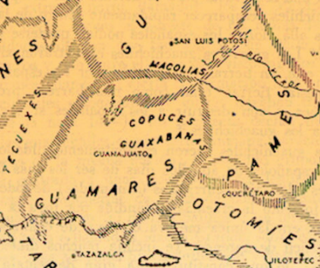
The Guamares
The nation of the Guamares, located in the Guanajuato Sierras, was centered around Penjamo and San Miguel and stretched eastward beyond the present City of Guanajuato.
The author Gonzalo de las Casas called the Guamares "the bravest, most warlike, treacherous, and destructive of all the Chichimecas, and the most astute (dispuesta)." Like Guachichiles, the Guamares pained their body in red and white colors. The map at the right shows that the Guamares occupied the largest segment of Guanajuato, with the Pames and Otomies to their east.
.
Sources: Philip Wayne Powell, “Soldiers, Indians and Silver: North America's First Frontier War" (Tempe, Arizona: Center for Latin American Studies, Arizona State University, 1973); Peter Masten Dunne, “Pioneer Jesuits in Northern Mexico” (19444).
Copyright © 2019 by John P. Schmal.
All Rights Reserved.

Slide 13
The Pames
As illustrated in the map by Philip Wayne Powell on the preceding page, the Pames lived to the east of the Guamares. The Pames also lived south and east of the Guachichiles, and their territory blended with the Otomies on the south.
The Pames — who today call themselves Xi'úi, which means “native” — were a seminomadic tribe, constituting a very divergent branch of the Otomanguean linguistic family. They were located mainly in the southeastern part of San Luis Potosi, as well as adjacent areas of Tamaulipas, Querétaro and Guanajuato.
Initially, the Pames were minor players in the Chichimeca War. According to Professor Frye, they took part in small raids on cattle ranches in the Bajío. However, in the 1570s, they became more involved in the hostilities, but settled down peacefully when the war ended.
With the influx of Spanish settlers, the nomadic Pames and Jonaces retreated into the rugged mountains of the Sierra Garda (now in Querétaro, eastern Guanajuato and San Luis Potosí). Most of this area would remain effectively outside of Spanish control until the early Eighteenth Century. Today — unlike most of the Chichimeca groups participating in the 1550-1590 war — the Pames continue to exist as a cultural group with a living language.
Sources: Philip Wayne Powell, “Soldiers, Indians and Silver: North America's First Frontier War" (Tempe, Arizona: Center for Latin American Studies, Arizona State University, 1973); David Frye, “The Native peoples of Northeastern Mexico,” in Richard E. W. Adams and Murdo J. MacLeod, The Cambridge History of the Native Peoples of the Americas, Volume II: Mesoamerica, Part 1 (Cambridge, U.K.: 2000).

Slide 14
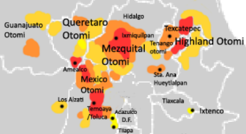
The Otomí Indians (The Sierra Nahñu)
The Otomíes were a Chichimeca tribe, occupying present-day Querétaro, Guanajuato, Hidalgo and parts of the state of México. At one time, the Otomí held a great deal of power and prestige throughout east central Mexico. However, the rise of the Aztec Empire caused a decline of the Otomíes during the 14th Century.
Early on, most of the Otomíes allied themselves with the Spaniards and Mexica Indians. As a result, writes Dr. Powell, Otomí settlers were “issued a grant of privileges” and were “supplied with tools for breaking land.” For their allegiance, they were exempted from tribute and given some of autonomy in their towns. Today, the Otomí (who call themselves Nahñu, or Hñahñu) speak the seventh most common language group in Mexico.
Areas Where the Otomí Language is Presently Spoken
Source: Wikipedia, “The Otomi-Speaking Areas in Mexico” (Public Domain Map Created 14 August 2009).
Copyright © 2019 by John P. Schmal.
All Rights Reserved.

Slide 15
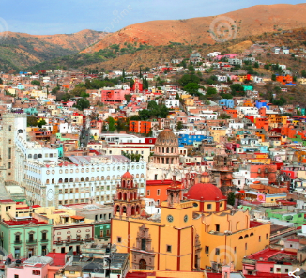
The City of Guanajuato
The City of Guanajuato
The Spaniards arrived in the region in 1522, led by Cristóbal de Olid. In 1552, Captain Juan de Jaso discovered mineral deposits in the Guanajuato region and subsequently established Real de Minas (The Royal Mines).
In the 1550s, Spanish entrepreneurs began to exploit the rich veins of silver in the mountains surrounding the city. The indigenous tribes in the Guanajuato region had noticed the numerous frogs in the area and referred to it as “Quanax-juato,” combining the Tarascan “quanas” (frogs) and “huato” (mountainous), which essentially means a high place with many frogs. The Spaniards would later translate Quanax-juato into Guanajuato.
The Town of Guanajuato was founded in 1554, but it did not receive the title of Ciudad (City) until 1741. The discovery of silver in the region led to rapid settlement by the Spanish throughout the 16th and 17th centuries.
15
Copyright © 2019 by John P. Schmal.
All Rights Reserved.

Slide 16
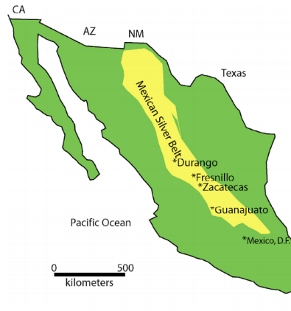
Mexico’s Silver Belt Runs Through Guanajuato
Today, Mexico is the world’s leading producer of silver with 21% of global production, followed by Peru (15%), China (12%) and Australia and Russia (each 6%).
Mexico’s “La Faja de Plata” (The Silver Belt) runs 1,000 km from NW of Mexico City to Chihuahua and is the most prolific mining district in the world, with a historical production of more than 10,000 million ounces of silver (311,000 tons).
Many of the major mines in the belt include Guanajuato, Zacatecas, Fresnillo, Santa Eulalia, Parral-Santa Barbara-San Francisco del Oro, and Charcas, all of which have been in nearly continuous production since the 16th century.
Source: University of Texas at Dallas, “Colonial Silver- Potosi (Bolivia) and Guanajuato (Mexico).”
Copyright © 2019 by John P. Schmal.
All Rights Reserved.

Slide 17
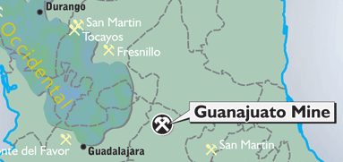
Guanajuato’s Silver Wealth
Guanajuato’s silver wealth lies near the southeastern end of the famous Silver Belt running through central Mexico. Silver mining in Guanajuato first began in 1548 along the great “Mother Lode. ” In 1558, the site of the Veta Madre Mine was discovered. It became an integral part of the famous Guanajuato Mine Complex. The Guanajuato Mining District is one of the most prolific and best-known silver districts in the world. During the 18th century, the district was reportedly producing one-third of the world's silver. Today, the Valenciana Mine is still believed to be one of the richest silver mines in the world.
Source: University of Texas at Dallas, “Colonial Silver - Potosi (Bolivia) and Guanajuato (Mexico).”
Map Source: CBR (Canadian Business Resource), “Great Panther Silver Limited: Mexican Projects.”
Copyright © 2019 by John P. Schmal.
All Rights Reserved.

Slide 18
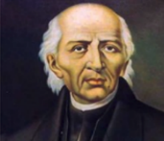
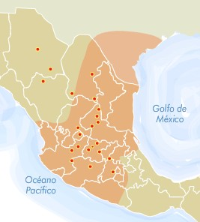
Hidalgo’s Peasant Insurrection
On September 16, 1810, Father Miguel Hidalgo rang the town’s church bells of his Guanajuato parish to call the people to mass. He then gave his famous speech, the Grito de Dolores, or Cry of Dolores. What started as a small rebellion quickly snowballed into a full-scale revolution. Gathering recruits from the countryside, Hidalgo’s peasant army of mestizos and indios grew to 80,000 men and marched 120 miles (193 km) south to Mexico City.
Moving from one town to another through Guanajuato, Michoacán, Mexico State and Jalisco, Hidalgo's insurgents were able to take control of some cities without firing a shot.
Fr. Miguel Hidalgo
Copyright © 2019 by John P. Schmal.
All Rights Reserved.
Hidalgo’s Regions of Support
18

Slide 19
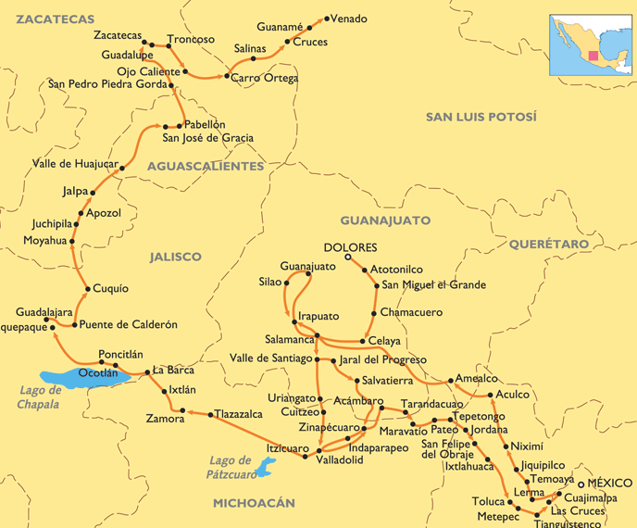
Hidalgo’s Campaigns (1810-1811)
In September 1810, Hidalgo’s peasant army seized Guanajuato City and a month later, they took Valladolid. However, the cities were taken back by royalist forces soon after.
Although Hidalgo gained a great deal of support around the country, his army eventually succumbed to professionally trained royal soldiers with superior weapons. Eventually he was captured, found guilty of treason, and executed by a firing squad on July 30, 1811. The war for independence would not end until 1821.
The Campaign of Father Miguel Hidalgo, Sept. 1810 to March 1811.
Map Source: Rodrigo Moreno, Independencias Iberoamericanas (Colegio de Historia, Facultad de Filosofía y Letras, UNAM).
Copyright © 2019 by John P. Schmal.
All Rights Reserved.
19

Slide 20
The 1921 Mexican Census
Mexico’s 1921 census asked people to categorize themselves by three primary categories: Pure Indigenous, Indigenous Mixed with White, and White. The following table shows the racial categories for Guanajuato and its neighboring state of Michoacán.
.
The Racial Classifications of Michoacán and Guanajuato in the 1921 Census
Racial Classification | Guanajuato: No. of Persons | Guanajuato: % of Total State Population | Michoacán: No. of Persons | Michoacán: % of Total Population
Indígena Pura (Pure Indigenous) | 25,458 | 3.00% | 196,726 | 20.90%
Indígena Mezclada con Blanca (Mixed) | 828,724 | 96.30% | 663,391 | 70.60%
Blanca (White) | 4,687 | 0.50% | 64,886 | 6.90%
Question Ignored or Other Classifications | 1,395 | 0.20% | 14,101 | 1.50%
Total Population | 860,364 | 100% | 939,849 | 100%
Classifications: Indígena Pura (Pure Indigenous Origins); Indígena Mezclada con Blanca (Indigenous Mixed with White); Blanca (White); Extranjeros sin distinction de razas (Foreigners without racial distinction) One percent of the population of the Republic of Mexico chose a fifth option: “Cualquiera otra o que se ignora la raza” (persons who chose to ignore the question or “other.” Source: Departamento de la Estadística Nacional, “Annuario de 1930” (Tacubaya, Distrito Federal, 1932).
Copyright © 2019 by John P. Schmal.
All Rights Reserved.

Slide 21
Indigenous Guanajuato Today
In the 2010 census, Guanajuato ranked 30th among the Mexican states and the Distrito Federal in its percentage of indigenous speakers. In fact, only 0.3% of Guanajuato’s residents actually spoke an indigenous language. More than one-third of the 15,204 indigenous speakers 3 years and older in Guanajuato in the 2010 census did not specify which language they spoke, as noted in the following table.
The 2010 Census: Indigenous Languages Spoken in Guanajuato
Indigenous Language | Population 3 Years and Older Who Speak an Indigenous Language | Percent of all Indigenous Speakers
Unspecified Indigenous Language | 5,331 | 35.1%
Otomí | 3,239 | 21.3%
Chichimeca Jonaz | 2,142 | 14.1%
Náhuatl | 1,264 | 8.3%
Mazahua | 818 | 5.4%
Purépecha (Tarasco) | 568 | 3.7%
Other Languages | 1,842 | 12.1%
Total | 15,204 | 100.0%
Source: INEGI. Censo de Población y Vivienda 2010: Tabulados del Cuestionario Básico: Población de 3 años y más que Habla Lengua Indígena por Entidad Federativa y Lengua.
Copyright © 2019 by John P. Schmal.
All Rights Reserved.

Slide 22
Guanajuato’s Most Indigenous Municipios in 2010
As noted in the following table, over half (50.2%) of Guanajuato’s indigenous speakers lived in three municipios: León, San Luis de la Paz and Tierra Blanca.
The 2010 Census: The Most Indigenous Municipios of Guanajuato
Municipio | Speakers of Indigenous Languages 3 Years of Age and More | % of the Total Indigenous Speakers in the State | Most Spoken Indigenous Language in Municipio | % of the Total Indigenous Speakers in Municipio | Second Most Spoken Language in Municipio | % of the Total Indigenous Speakers in Municipio
León | 3,270 | 21.5% | Náhuatl | 11.7% | Otomí | 7.5%
San Luis de la Paz | 2,273 | 15.0% | Chichimeco Jonaz | 93.0% | Náhuatl | 0.6%
Tierra Blanca | 2,090 | 13.7% | Otomí | 97.5% | Náhuatl | 0.2%
Celaya | 1,279 | 8.4% | Náhuatl | 13.8% | Otomí | 11.3%
Irapuato | 1,019 | 6.7% | Náhuatl | 11.9% | Otomí | 3.8%
San Miguel de Allende | 629 | 4.1% | Otomí | 47.4% | Náhuatl | 17.0%
Other 40 Municipios | 4,644 | 30.5% | Otomí | 10.1% | Náhuatl | 9.9%
Guanajuato | 15,204 | 100.0% | Otomí | 21.3% | Chichimeco Jonaz | 14.1%
Source: INEGI, 2010 Censo: Población de 3 Años y Más por Entidad y Municipio Según Habla Indígena y Lengua.
Copyright © 2019 by John P. Schmal.
All Rights Reserved.

Slide 23
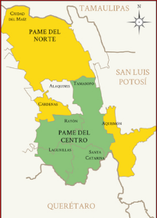
The Pameria
Today, the Xiúi region — known as “The Pameria” — occupies five municipios of San Luis Potosí (Ciudad del Maíz, Alaquines, Tamasopo, Rayón and Santa Catarina) and three communities in the Queretaro municipio of Jalpan de Serra. Pameria municipios in SLP run from the northern border with Tamaulipas to the southern border with Querétaro (in a narrow portion of the state).
The map on this page shows the regions in which the Pame language variants are spoken today. In the 2000 Mexican census, the Pame only numbered 8,312 in the entire Mexican Republic. The largest share of Pame speakers -- 7,975 individuals – lived in SLP, representing 95.9% of their total population. Their linguistic cousins, the Chichimeca-Jonaz, live in Guanajuato.
Map Source: “Pame,” Arqueología Edición Especial No. 85. Online:
https://arqueologiamexicana.mx/lenguas-indigenas/pames.

Slide 24
The Chichimeca-Jonaz
The Chichimeca-Jonaz language belongs to the Oto-Manguean language family and is divided into two major dialects: the Pame dialect, which is used in San Luis Potosí, and the Jonaz dialect used in Guanajuato. With a total of 1,433 Chichimeca-Jonaz speakers living in the state of Guanajuato in 2000, it is interesting to note that 1,405 of this group actually lived in the municipio of San Luis de la Paz in the northwestern section of the state.
From 1713 to 1715, Spanish general Gabriel Guerrero de Ardela led a force of 800 cavalry into the Sierra Gorda to contain the Jonaces and end their fierce resistance to Spanish rule. In February 1715, he achieved victory over the Jonaces and signed a subsequent treaty with the Indians, ensuring their freedom and control over the Sierra Gorda.
In 2010, 2,295 speakers of Chichimeca-Jonaz were registered. The language is rare but is not believed to be in immediate risk of disappearance.

Slide 25
The 2015 Intercensal
INEGI’s 2015 Intercensal Survey, published in 2016, indicated that the % of people who are traditionally indigenous exceeds the % of people who actually speak indigenous languages. The data for Guanajuato and selected neighboring states are shown below.
Linguistic and Ethnic Identity in Mexico (2015)
State | Status | % of the Total Population That Consider Themselves to be Indigenous | % of Persons 3 Years of Age and Older Who Speak an Indigenous Language
Oaxaca | No. 1 in Mexico | 65.7% | 32.2%
Yucatán | No. 2 in Mexico | 65.4% | 28.9%
Michoacán | Neighboring State | 27.7% | 3.6%
Guanajuato | Subject State | 9.1% | 0.2%
Colima | Neighboring State | 20.4% | 0.6%
Querétaro | Neighboring State | 19.2% | 1.7%
Aguascalientes | Neighboring State | 11.7% | 0.3%
Jalisco | Neighboring State | 11.1% | 0.8%
Zacatecas | Neighboring State | 7.6% | 0.3%
The Mexican Republic | All States Combined | 21.5% | 6.5%
Source: INEGI, “Principales resultados de la Encuesta Intercensal 2015. Estado Unidos Mexicanos: III: Etnicidad.” Online: http://www.senado.gob.mx/comisiones/asuntos_indigenas/eventos/docs/etnicidad_240216.pdf
Copyright © 2019 by John P. Schmal.
All Rights Reserved.

Slide 26
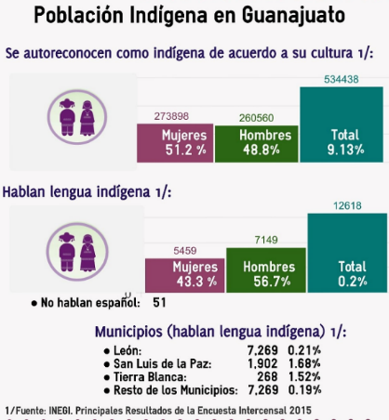
Guanajuato and the 2015 Intercensal
Source: Secretaría de Educación del Estado de Guanajuato, “Población Indígena en Guanajuato.”
Copyright © 2019 by John P. Schmal.
All Rights Reserved.

